Slide 1


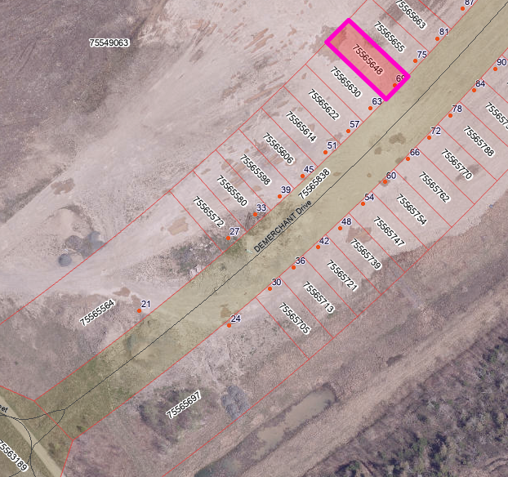
Parcel Summary
69 DeMerchant Drive, Fredericton
Housing Accelerator Fund
69 DeMerchant Drive is a standard building lot located on the North Side of Fredericton. Located off Cuffman Street, the property is close to several schools, and commercial complexes including gas stations, food and beverage establishments, and retailers. Located along bus routes and in close proximity to recreational complexes and active transportation trails.
Site Details
PID | 75565648
Civic | 69 DeMerchant Drive
Assessed Value | $60,800.00
Site Services | Municipal water & sewer
Zoning | R-5
Lot Size | 345 m²
Distance to Amenities
Elementary School | 450 m
High School | 1.3 km
Grocery Store | 2.9 km
Bus Stop | 1 km
Public Park | 450 m
Permitted Housing Types
Single Detached Dwelling Duplex Dwelling | Semi-detached Dwelling Townhouse
This lot is available to buyers who qualify for the Affordable Home Ownership Program which is administered by the City of Fredericton. More information on the Program and application details can be found at (insert link to program).
For more information contact:
Ryan Seymour
Manager of Real Estate
City of Fredericton
P: 506-460-2637
ryan.seymour@fredericton.ca

